Slide 1
ASD Project
Bluetooth controlled
Projector Screen
Made by -
Manoj - 083
Meghashyam - 084
Shahid - 085
Yaseen - 086
Mohinish - 087

Slide 2
Idea
A motorized, Android and Arduino controlled, Bluetooth enabled, screen.
Completely unmanned…….controlled and operated by a mobile app.
The app communicates with the microcontroller ( arduino ) via bluetooth which in turn operates the motor which raises and lowers the projector screen…….

Slide 3
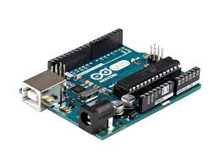
COMPONENTS USED
The Real stuff now
Here’s what we are going to need
1x Arduino UNO board
1x PN2222 Transistor
1x Small 6V DC Motor
1x 1N4001 diode
1x 270 Ω Resistor
Bluetooth module (thanks Pratyush)

Slide 4
Working
Using arduino microcontroller and a wireless controller we intend to control the board’s output to control a motor and an attached rod to control the movement of the projector screen.
There are three separate circuits interfacing with the Arduino: the motor and it's controller, the Bluetooth module and it's Android interface.

Slide 5
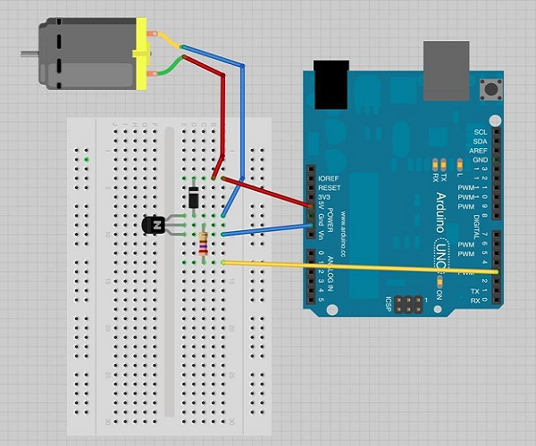
This is the outline of the circuit with which we can control the motor using the arduino…
But that’s not what we are interested in…
We will control the motor via Bluetooth….

Slide 6
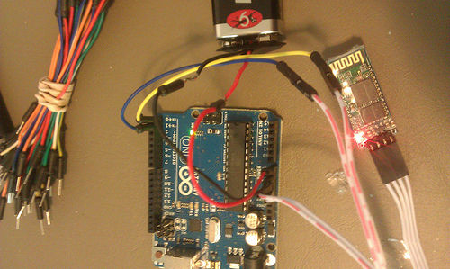
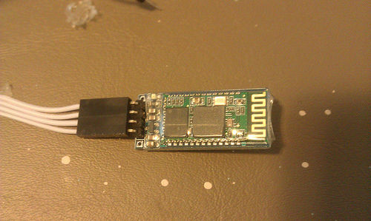
This is how it’s gonna look…. The same little thing… Bluetooth module included..
Bluetooth module

Slide 7
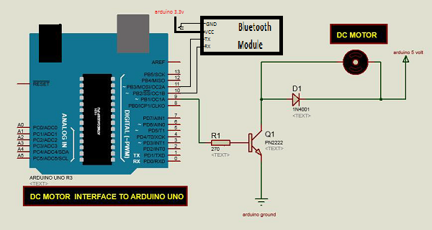
Final Circuit

Slide 8
A little about the BOARD
Microcontroller | ATmega328
Operating Voltage | 5V
Input Voltage (recommended) | 7-12V
Input Voltage (limits) | 6-20V
Digital I/O Pins | 14 (of which 6 provide PWM output)
Analog Input Pins | 6
DC Current per I/O Pin | 40 mA
DC Current for 3.3V Pin | 50 mA
Flash Memory | 32 KB (ATmega328) of which 0.5 KB used by bootloader
SRAM | 2 KB (ATmega328)
EEPROM | 1 KB (ATmega328)
Clock Speed | 16 MHz

Slide 9
Key Features of ATMega 328
CPU type | 8-bit AVR
Performance | 20 MIPS at 20 MHz^{[2]}
Flash memory | 32 kB
SRAM | 2 kB
EEPROM | 1 kB
Pin count | 28-pin PDIP, MLF, 32-pin TQFP, MLF^{[2]}
Maximum operating frequency | 20 MHz
Number of touch channels | 16
Hardware QTouch Acquisition | No
Maximum I/O pins | 26
External interrupts | 2
USB Interface | No
USB Speed | No

Slide 10
Memory
The ATmega328 has 32 KB (with 0.5 KB used for the bootloader). It also has 2 KB of SRAM and 1 KB of EEPROM (which can be read and written with the EEPROM library).
Input and Output
Each of the 14 digital pins on the Uno can be used as an input or output, using pinMode(), digitalWrite(), and digitalRead() functions. They operate at 5 volts. Each pin can provide or receive a maximum of 40 mA and has an internal pull-up resistor (disconnected by default) of 20-50 kOhms. In addition, some pins have specialized functions:
Serial: 0 (RX) and 1 (TX). Used to receive (RX) and transmit (TX) TTL serial data. These pins are connected to the corresponding pins of the ATmega8U2 USB-to-TTL Serial chip.
External Interrupts: 2 and 3. These pins can be configured to trigger an interrupt on a low value, a rising or falling edge, or a change in value. See the attachInterrupt() function for details.
PWM: 3, 5, 6, 9, 10, and 11. Provide 8-bit PWM output with the analogWrite() function.
SPI: 10 (SS), 11 (MOSI), 12 (MISO), 13 (SCK). These pins support SPI communication using the SPI library.
LED: 13. There is a built-in LED connected to digital pin 13. When the pin is HIGH value, the LED is on, when the pin is LOW, it's off.
The Uno has 6 analog inputs, labeled A0 through A5, each of which provide 10 bits of resolution (i.e. 1024 different values). By default they measure from ground to 5 volts, though is it possible to change the upper end of their range using the AREF pin and the analogReference() function. Additionally, some pins have specialized functionality:
I²C: A4 (SDA) and A5 (SCL). Support I²C (TWI) communication using the Wire library.
There are a couple of other pins on the board:
AREF. Reference voltage (0 to 5V only) for the analog inputs. Used with analogReference().
Reset. Bring this line LOW to reset the microcontroller. Typically used to add a reset button to shields which block the one on the board.

Slide 11
Now the Demo(A.k.a “the fun part”)

Slide 12
Thank you

